Slide 1

Fall Armyworm Supervised
AI Detection
TechCrush Artificial Intelligence Capstone Project
(Cohort 3)
[ Prepared by Group U ]

Slide 2
Abstract / Executive Summary
This project presents an AI-based supervised learning approach to detect Fall Armyworm infestations from crop images. Using DenseNet121 (a pre-trained CNN), our model achieved more than 90% test accuracy and 0.98 F1-score in classifying Healthy vs FAW-Damaged crops.
The trained model was exported to ONNX for deployment in mobile and cloud environments, providing a scalable early warning system for pest control in agriculture.

Slide 3
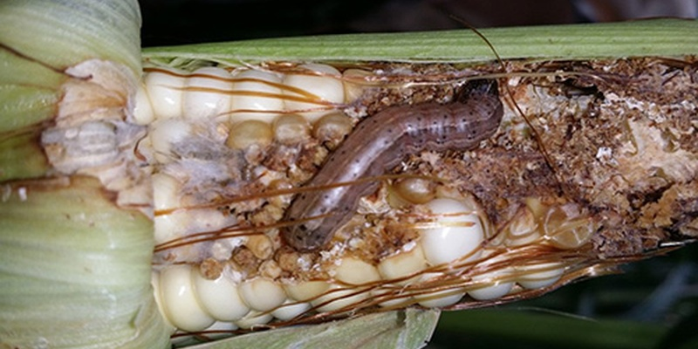
Fall Armyworm (FAW)
A destructive moth pest (Spodoptera frugiperda) whose larvae feed on crops.
Attacks over 80 plant species, mainly maize, rice and sorghum.
Causes about 31% annual maize yield loss in Africa, threatening food security.

Slide 4
Project Goal & Objectives
Goal
Develop a supervised machine learning
model to detect Fall Armyworm using visual data.
Classify crop images as either Healthy Crop or FAW Damaged.
Objectives
Apply Supervised learning principles
Train and evaluate a compact image classification model
Export model in ONNX format for deployment
Reproducibility

Slide 5
Project Methodology
Data Loading & Preprocessing
Load FAW Dataset
Clean and augment images (rotation, flipping, resizing)
Model Selection & Training
Train using CNN pre trained models (e.g., MobileNetV2, EfficientNetB0, ResNet50)
Pick the best performing model using f1-score and recall metrics to evaluate (DenseNet121)
Tune hyperparameters for optimal accuracy
Research and Evaluation
Measure Accuracy, Precision, Recall, and F1-Score.
Visualize training and validation performance
Open Neural Network Exchange (ONNX) Export
Convert the trained model to ONNX format for portability

Slide 6
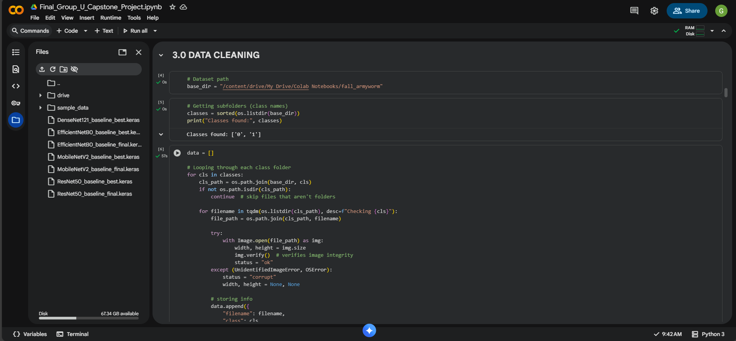
Development Environment

Slide 7
Dataset and Preprocessing
Parameters | Details
Data Source | Kaggle, Google, Roboflow
Classes | FAW Damage (1) and Healthy (0) images
Total images | 2,989 (1,882 FAW Damage and 1,107 Healthy images)
Preprocessing | Resized(224 X 224),Normalized (0–1), Split (70% Train, 15% Validation, 15% Test)
Data Augmentation Libraries | Rotation, Flipping, Zoom, Brightness adjustment TensorFlow and Keras for data loading and augmentation

Slide 8
Data Summary
Class | Description | Image Count
0 | Healthy Crop | 1107
1 | FAW Damage | 1882
Total | — | 2989
Dataset combined from Kaggle, Roboflow, and Google sources
Augmentation applied to handle imbalance (flipping, rotation, contrast)
Images resized to 224×224 pixels.

Slide 9
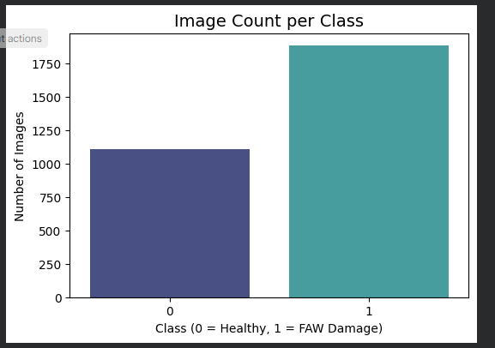
Class Distribution

Slide 10
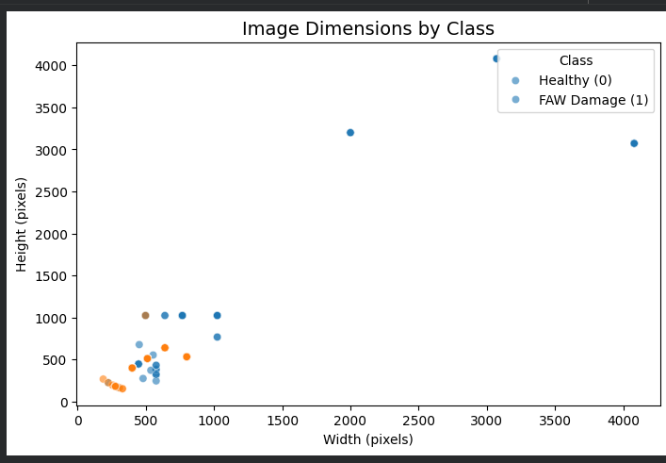
Image Dimensions by Class

Slide 11
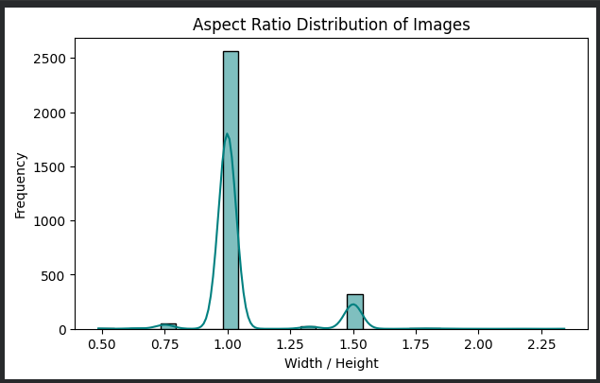
Aspect Distribution of Images

Slide 12
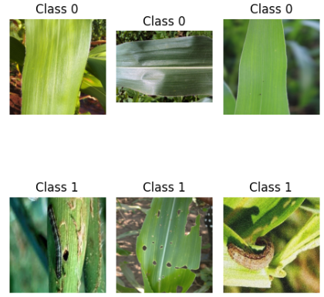
Random Image Samples

Slide 13
Model Architecture and Training
Architecture:
Model type: Convolutional Neural Network
Pre Trained CNN Model: DenseNet121
Framework: TensorFlow/Keras
Class Names: Healthy Crop (0) and FAW Damage (1)
Training Set –Up:
Epochs: 15
Batch Size: 32
Learning rate: 0.0001
Train: 2092 images
Validation: 448 images
Test: 449 images

Slide 14
Fine-Tuning and Optimization
Model Fine-Tuning Process:
Unfroze top convolutional layers of DenseNet121
Reduced learning rate from 1e-4 → 1e-5 for stable training.
Increased training epochs to improve recall.
Applied early stopping and checkpointing.
Resulted in improved validation accuracy (0.78 → 0.97) and F1-score (0.78 → 0.98).

Slide 15
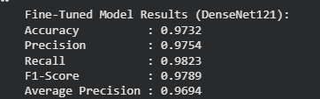
Evaluation and Results

Slide 16
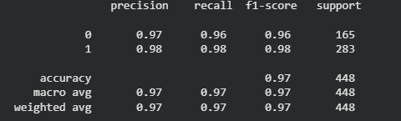
Classification Report

Slide 17
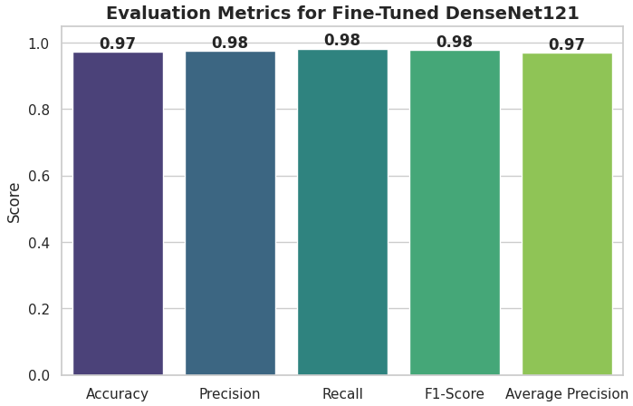
Evaluation Metric

Slide 18
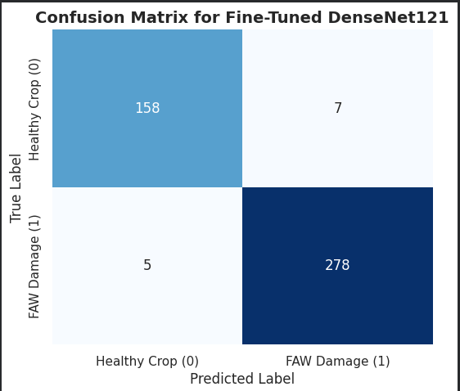
Confusion Matrix

Slide 19
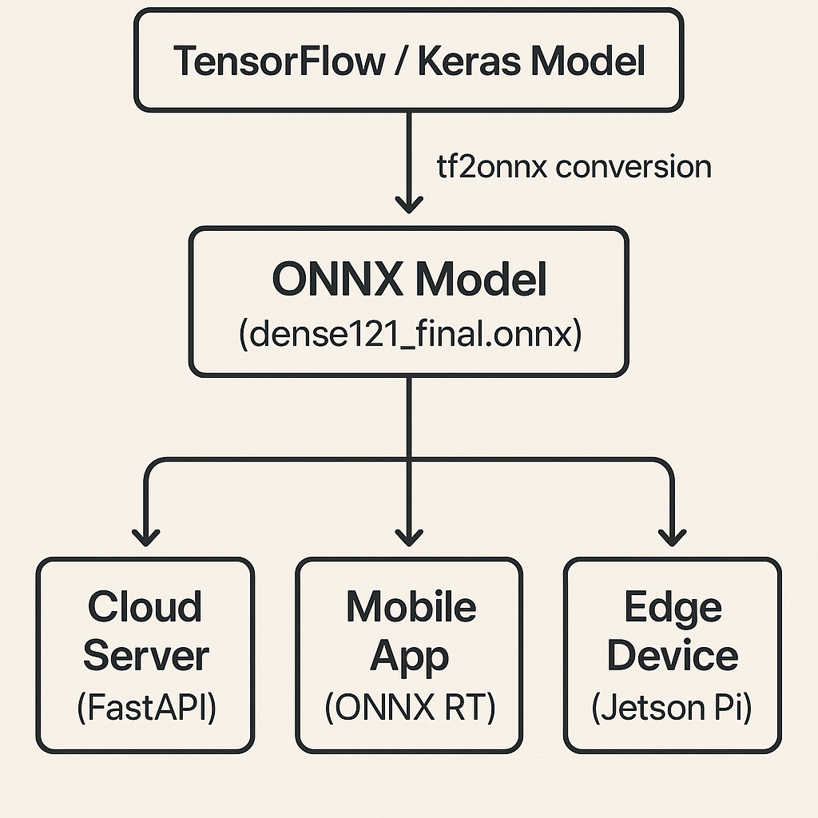
Model Deployment (ONNX)
Exporting the Trained Model for Deployment:
The final DenseNet121 model was exported to the ONNX (Open Neural Network Exchange) format.
ONNX serves as a universal AI model format, enabling deployment across frameworks and devices.
This ensures the model can run without retraining in other environments.
The exported file, DenseNet121_finetuned_final.onnx, is fully compatible with ONNX Runtime.
Supports deployment on Web and Mobile apps

Slide 20
Real-World Impact
Agricultural Relevance and Impact
Early detection of Fall Armyworm infestations via mobile or drone imagery.
Provides farmers with real-time alerts for pest outbreaks.
Helps reduce crop damage and improve food security.
Scalable for integration with IoT or drone-based monitoring systems.
Portable ONNX format ensures use on mobile, web, and edge devices.

Slide 21
Future Work / Next Steps
Future Enhancements
Expand dataset with more crop types and regions.
Add multi-class classification for other pests.
Helps reduce crop damage and improve food security.
Deploy a mobile or web app interface for real-time detection.
Integrate with drone and IoT surveillance platforms.
Explore quantization or TensorRT for faster inference.

Slide 22
Team Roles and Contributions
Team Structure and Contributions:
Role / Task | Member(s) | Key Contribution
Team Lead / Integration | Goodluck | Coordination, GitHub setup, model pipeline, ONNX export
Data Collection & Preprocessing | Faiz, Chinazor, Kazeem, Similoluwa | Dataset sourcing, augmentation, cleaning
Model Training & Evaluation | Thankgod, Lawal, Joyce, Deborah, Zibahkesh, Jeffery, Opeyemi | CNN architecture setup, fine-tuning, metric evaluation
Documentation & Reporting | Daniel, Jesse, Christabel, Aisha, Augustine | Notebook writing, visualizations, report compilation
Presentation & Review | All members | Slide design, final presentation preparation

Slide 23
Acknowledgment / Conclusion
Acknowledgment:
We appreciate the support and guidance of our mentor, Mr. Hammed Obasekore, and the AI Bootcamp organizing team.
This project represents our shared commitment to applying AI for agricultural innovation and sustainable food security in Africa.

